Slide 1
Controlling Multithreaded Applications Part 1
SET10108 Concurrent and Parallel Systems

Slide 2
Breakdown
Problems with multithreading
Locking
Waiting

Slide 3
Problems with Multithreading

Slide 4
Counter
A simple example that shows the problem with nondeterminism is building a counter operated by 4 threads
The counter is incremented by any thread at any time
There is no locking or other method of control on the counter
We essentially have no way of determining which thread will go next

Slide 5
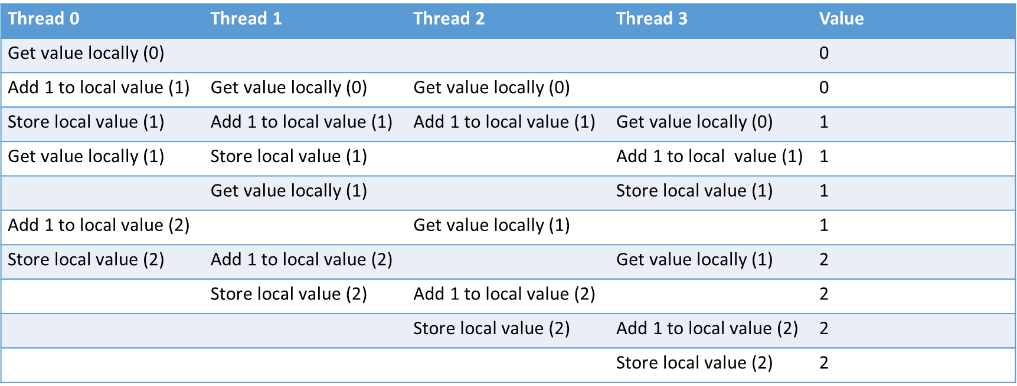
Counter

Slide 6
Race Conditions
Who remembers what we mean by a race condition?
A race condition is where output is determined by the sequence and timing of uncontrolled events – in other words it is a race to see which process / thread access the data
Race conditions are the first thing we want to avoid when dealing with multithreaded / concurrent applications

Slide 7
Is this really a big deal?
Race conditions in the Therac-25 radiation therapy machine led to the death of at least three patients and injuries to several more
Energy Management System provided by GE Energy had a race condition in the alarm subsystem that prevented alerts and eventually led to the North American Blackout of 2003
In security-conscious code, a security vulnerability called a time-of-check-to-time-of-use (TOCTTOU) bug is created

Slide 8
Non-determinism
In any MIMD application if there is no control we start to see nondeterminism
In simple terms, nondeterminism is where a given input can result in different outputs
Not the same as random, but you could simplify your understanding to this
Nondeterminism, and dealing with nondeterminism, is one of the key goals in concurrency modelling and system design
Non-deterministic choice is a common operator in modelling. You would have touched on this in Fundamentals of Parallel Systems

Slide 9
References and Shared Data
The biggest issue when working with threads is that they share a processes memory
We have looked at simple counters and primitives when working with shared memory, but these are not the main issue
Our main problem comes from working with complex data structures such as tables, lists and trees
You have to be really careful about what you are accessing and sharing – you could easily return a pointer to shared data with no control
Guarded objects are a good solution to this

Slide 10
Data Structure Problems

Slide 11
Locking

Slide 12
Bit of History – the Semaphore
You are probably familiar with the concept of a mutex
Mutual exclusion lock on a piece of code
The semaphore was the first method of trying to control concurrency
See Edsger Dijkstra’s 1965 paper “Cooperating Sequential Processes”
A semaphore works on the concept of tokens
A semaphore has a fixed number of tokens
When a process wishes to access a resource it acquires a token
When it is finished it releases the token
A semaphore provides just two operations
Wait – acquire or wait for a token
Signal – release a token and signal any waiting processes

Slide 13
Bit of History – the Semaphore
Think of it as a (simplified) restaurant
A restaurant has a fixed number of tables
To get a table, you ask at the front desk
The front desk decrements the number of tables available and someone shows you to a table
When someone leaves, the front desk increments the number of tables available
If no tables are available, you have to wait
The front desk only knows the number of tables available – it doesn’t keep track of who is sitting where

Slide 14

Mutexes
A mutex extends the notion of a semaphore in a number of ways
The mutex only allows one process in at a time – it is equivalent to a binary semaphore
The mutex has an owner – this is a very useful safety feature
Mutexes are far more common to the programmer
The OS will likely have semaphore support however

Slide 15
Lock Guard
In C++11 we typically use lock guards to work with mutexes
Acquire lock when created
Release lock when destroyed
This is usually better for guarding methods
Create lock guard as first instruction of method
When method exits, lock is destroyed
Mutex requires specific calls to lock and unlock
Difficult to track
// Loop 1 million times, incrementing value
for (int i = 0; i < 1000000; ++i)
{
// Create the lock guard
lock_guard<mutex> lock(mut);
// Increment value
*value = *value + 1;
// lock guard destroyed
}

Slide 16
Guarded Objects
In object orientation we usually want to create protected objects
Lock guards provide a simple means of doing this
Object has a mutex
A method call has at its first instruction a lock guard creation
Only one method can be executed on the object at a time
This is the standard pattern for OO based locking
class guarded
{
private:
mutex mut;
int value;
public:
void guarded::increment()
{
lock_guard<mutex> lk(mut);
x = value;
x = x + 1;
value = x;
}
};

Slide 17
Spin Locks
A method becoming popular in some areas is the idea of a busy wait or a spin lock
Can anyone guess what a spin lock does?
A spin lock doesn’t wait – it tests for availability and if not available other processing takes place (or a timeout used) and the lock is tested again
This means we don’t have so many context switches, but does make the processor busier
We will look at spin locks in the next lecture

Slide 18
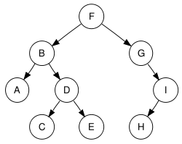
Data Structures
As mentioned last week, the main problem we have to think of is normally controlling data structures
This is the main OO problem when using guarded objects
The simple solution is to guard all methods – but this means only one thread can use the data structure at a time
We can be smarter – but it leads to complexity

Slide 19
Deadlock
Who remembers what deadlock means?
Deadlock occurs when two or more processes / threads can’t continue because of resources not being made available in the correct order
It is essentially a locking problem
Locking has removed our race hazard problem
Hooray!
But introduced deadlock problems!
Boo!

Slide 20
Avoiding Deadlock
Some techniques to avoid deadlock (taken from C++ Concurrency in Action)
Avoid nested locks – don’t acquire a lock when you hold one
Avoid calling user-supplied code while holding a lock
Acquire locks in a fixed order
Use a lock hierarchy
Extending these guidelines beyond locks – don’t wait while holding a lock for example

Slide 21
Livelock
Livelock is another problem that occurs with locking
Who remembers what livelocking means?
Livelock means that two or more processes don’t continue because they keep backing out of a lock – they are trying to let the other process through first
Livelock is a trickier problem to recreate and debug – things look like they are happening but they aren’t really

Slide 22
Waiting

Slide 23
Waiting for an Event - naively
Waiting for something to happen is the other side of locking
Locking allows protection of data – but what do we do if we want to go when an event occurs – we wait
We could do this naively
Use a flag
If flag is clear, grab the lock
If flag is not clear, wait for some time and try again
Problems?
Time between checking flag and acquiring lock could mean lock is acquired elsewhere
How much time to wait for?

Slide 24
Waiting for an Event - better
We can wait for a particular event to occur by using a mutex
In C++11, we have to build a condition variable
In Java and C#, any object can act as mutex and conditional
This is a better solution that the busy wait shown previously
condition.notify_one();
condition.wait(unique_lock<mutex>(mut));

Slide 25
Waiting with a Time Limit
We can also extend waiting to waiting with a time limit
Standard method is to just call wait
Conditional.wait(lock)
We can also use the following
Conditional.wait_for(lock, time)
Conditional.wait_until(lock, time)
Depending on your control flow, waiting and timed waiting can be advantageous

Slide 26
Building a Queue with Conditionals
Lets take a look at how we can build a queue using conditionals
We have two operations on a standard queue
Pop
Push
We are going to build a queue that allows communication between processes
The full code listing is in the C++ Concurrency in Action book
This is very similar to a construct many of you are familiar with. Can you guess?
A channel is just a queue with one space, meaning it can be full

Slide 27
Building a Queue with Conditionals
Our standard operations need to be extended
Push
Push adds data to the queue
It therefore needs to be thread safe (guarded object pattern)
Pop
Removes data from the queue
It therefore needs to be thread safe (guarded object pattern)
However we want to ensure communication between processes. What needs to happen?
We need to signal that we have sent a message – push must inform pop

Slide 28
Building a Queue with Conditionals
Revisiting our methods
Push
Lock the object
Add the data to the queue
Notify any waiting thread
Pop
Lock the object
Wait for queue to be non-empty (might already be)
Remove data from the queue
We now have a one way fire and forget channel

Slide 29
Building a Queue with Conditionals
We can extend this idea further
Push
Remains the same
Pop
We can wait and pop
Or we can try and pop – if no data is available carry on
A simple queue like this is a very powerful construct for building messaging passing systems such as pipelines
Hint for those of you who want to build a pipeline

Slide 30
Summary
We have covered three main aspects
The problems with multithreading – race hazards
Locking
Semaphores and mutexes
Deadlock and livelock
Waiting
Events and conditionals
These are the fundamental parts of multithreaded applications – the next lecture looks at more exotic approaches

